Slide 1



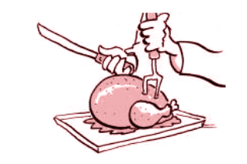

Exploring Effective Fuzzing Strategies to Analyze Communication Protocols
Yurong Chen, Tian Lan, Guru Venkataramani
ACM CCS FEAST 2019

Slide 2

Protocol fuzzers
Whitebox
sulley, boofuzz, …
generate packets based on known specifications
Blackbox
reverse protocol states/ packet formats: inaccurate

Slide 3
Coverage-guided greybox fuzzers
greybox fuzzers: AFL, AFL++, angora…
monitor program execution to get {execution paths, code coverage} as a feedback to guide further input mutation
Each basic block is assigned a unique ID during compilation
Each runtime execution path is then expressed by F(id₁, id₂, id₃,…)
Each input that trigger new value of F(id₁, id₂, id₃,…) will be given more resources of fuzzing (more air time and more mutation)

Slide 4

Challenges when applied to protocol fuzzing…
Distributed server and client programs
Multiple packet flights: multiple fuzzing
Stateful execution

Slide 5
Example

Slide 6
Goal of Design
Ideas
Able to store/reactivate protocol states
DFS (backtracing)
Able to fuzz any packet at any stage
Fork server
Able to switch fuzzing stage flexibly
Progression and regression policies
Stateful
Fuzzer
wanted
!

Slide 7
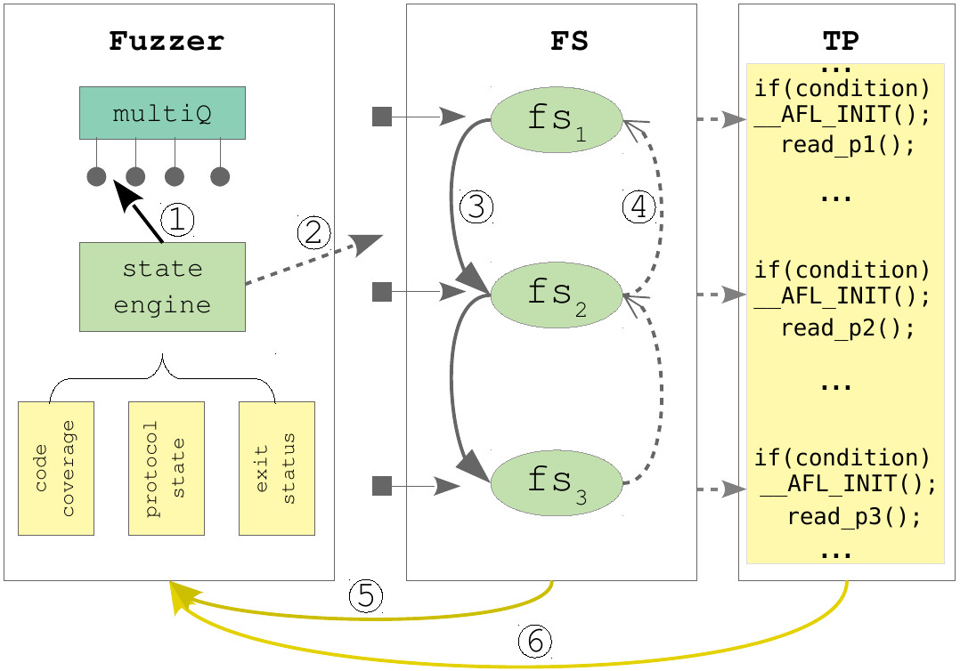
System Overview

Slide 8


AFL Forkserver
Developed to avoid repeated “execv()”, which is an expensive syscall. Instead, use “fork()” to spawn new fuzzing instances
1: Fuzzer forks a child process fork server (FS)
2: FS forks each child process to run testing program (TP)

Slide 9


State-aware fuzzer
Non-stateful:
State-aware:
Q1
Input 1
Input 2
Input 3
Input 1
Input 2
Input 3
Input 4
Q2
State
Engine
Input 1
Input 2
Input 3
Q3
Input 1
Input 2
Input 3
Feedback
COV
COV
Input 1’
Input’

Slide 10
Instrumenting testing programs (maybe delete)
Why?
Servers and clients are distributed
a standalone program is needed for fuzzing
How?
Utilize protocol APIs, put state transition together
Typically one complete session can be put into a while loop, such as OpenSSL handshake

Slide 11
Search Policy
Progression
Current state f1, when interesting p1 triggers new code coverage, trap f1 and fuzz p2
Regression
Current state f2, when fuzzing p2 is exhausted, step back to previous state f1, and continue fuzzing p1
DFS backtracking
f1 => f2 => f3 => f4 => f3’ => f2’ => f1’

Slide 12
Search Policy: what to monitor?
Key: variables that indicates state changes in the protocol
Indicators:
Code coverage
New packet flight
Packet change: packet type, length, or combined signature

Slide 13
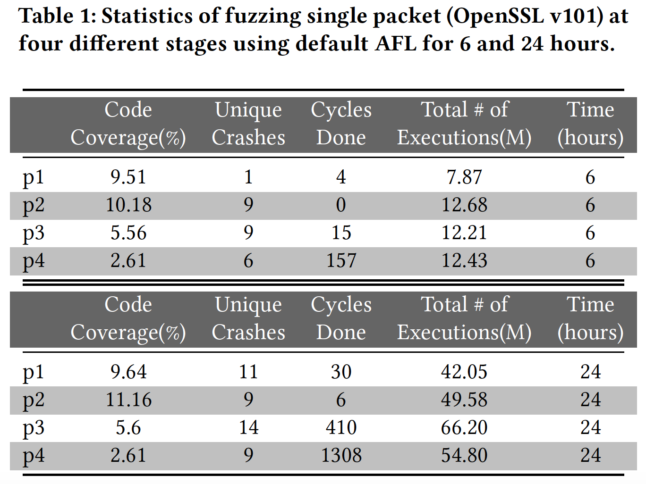
Single packet fuzzing
OpenSSL

Slide 14
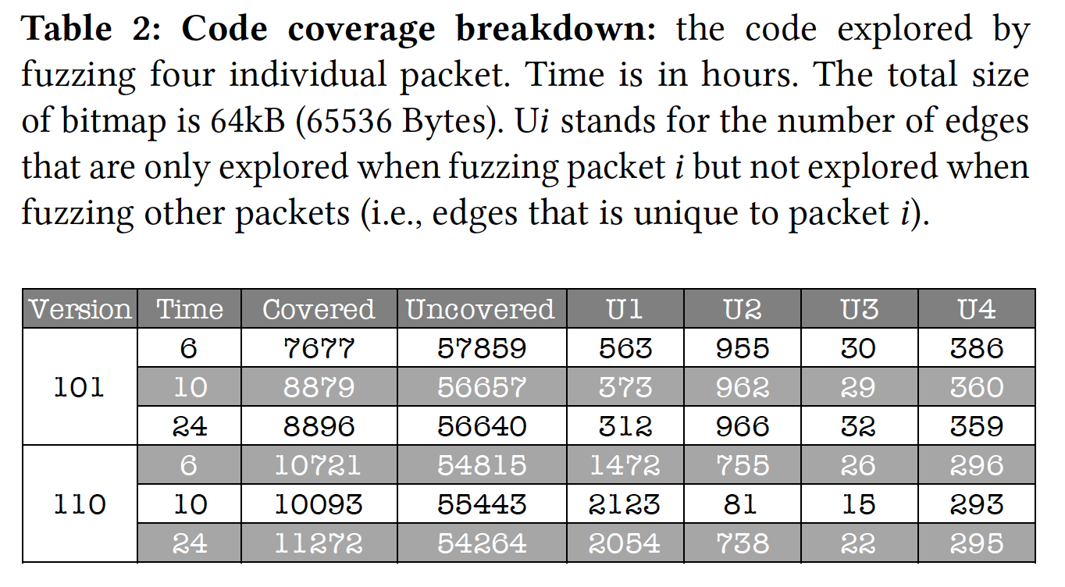
Stateful fuzzing
OpenSSL

Slide 15
Future work
Comparison among different Q power scheduling
Partial fuzzing: packet field fuzzing

Slide 16
Thank you!
N00014-17-1-2786 & N00014-15-1-2210

